Slide 1

Generating Deep Fake Left Ventricle Images for Improved Statistical Emulation
Vinny Davies & Andrew Elliott, University of Glasgow
Collaborators: Alan Lazarus (UoG), Hao Gao (UoG), Jose Antonio Oga (UoG), Stephen Law (UCL)

Slide 2
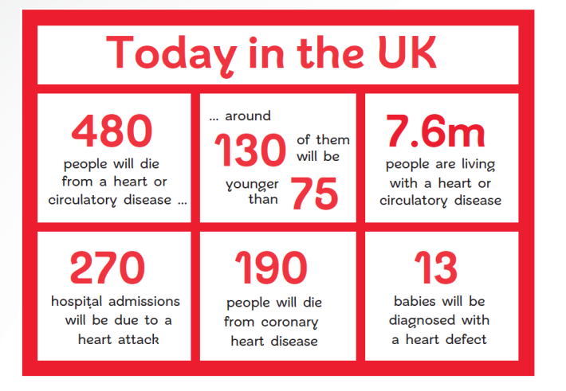
Heart Attacks
There are approximately 50,000 premature deaths from heart and circulatory diseases every year in the UK
Fast personalised treatment can help reduce the number of deaths
British Heart Foundation

Slide 3
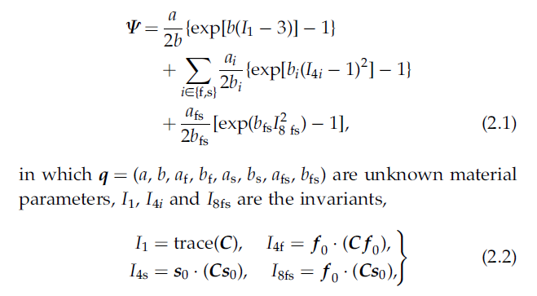
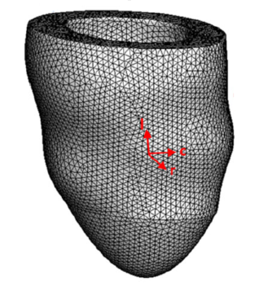
Mathematical Modelling
Mathematical modelling can help us understand muscle and fluid movements
Complex models exist for left ventricles and other parts of the heart

Slide 4
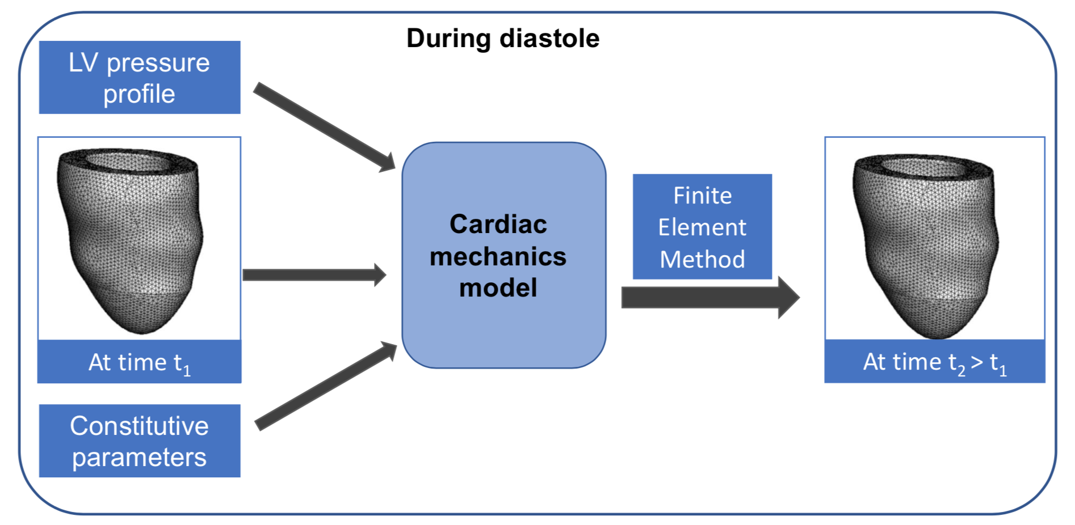
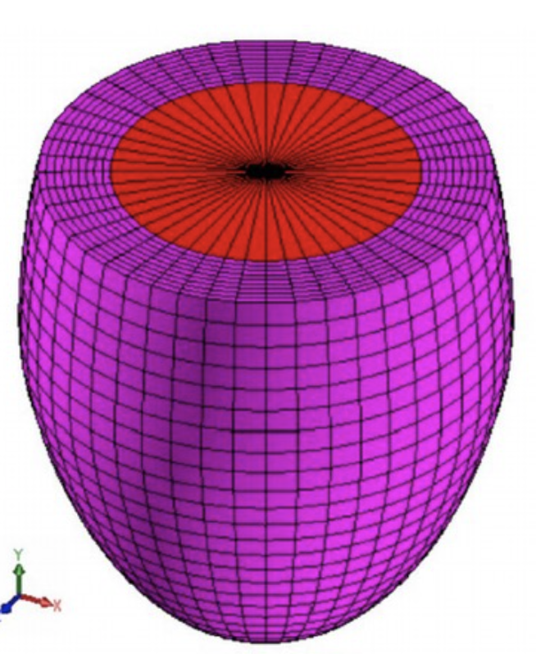
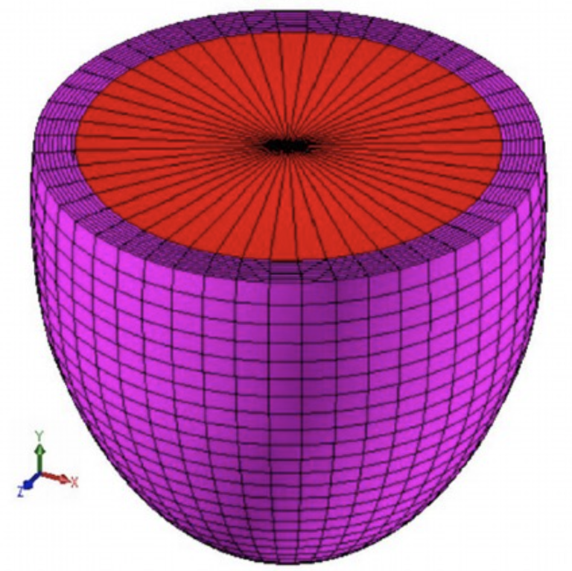
Modelling Process
Cardiac Mechanics Digital Twin
Figure thanks to Dirk Husmeier

Slide 5
Modelling Process
Cardiac Mechanics Digital Twin
Figure thanks to Dirk Husmeier

Slide 6
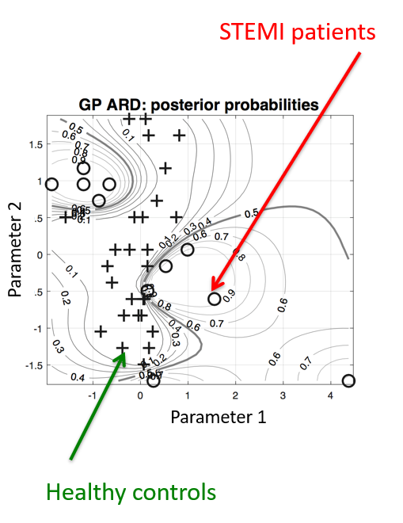
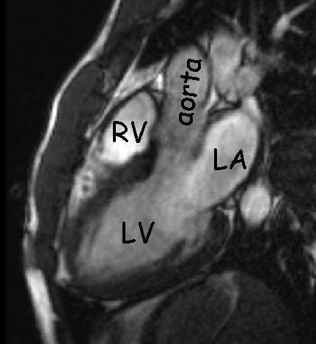
Advantages of Mathematical Models
Have interpretable real-world parameters
Parameters can be used as diagnostic tools for personalised medicine
Mathematical models essentially represent a digital twin of the left ventricle

Slide 7

Linking to Data
Cardiac Mechanics Digital Twin
Figure thanks to Dirk Husmeier

Slide 8
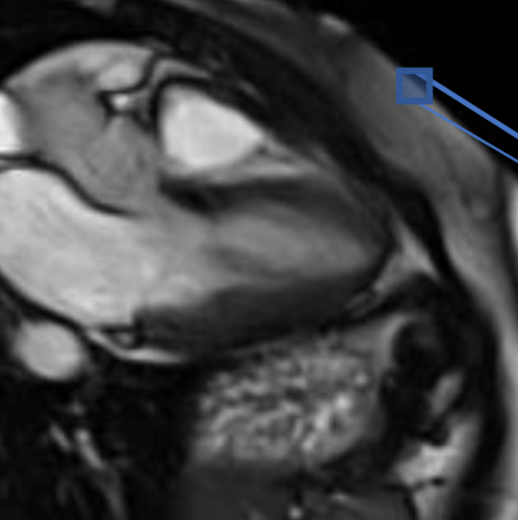
Linking to Data
Cardiac Mechanics Digital Twin
Figure thanks to Dirk Husmeier

Slide 9
Linking to Data
Cardiac Mechanics Digital Twin
Figure thanks to Dirk Husmeier

Slide 10

Learning Parameters
Cardiac Mechanics Digital Twin
Compare and minimise the difference to learn parameters
Figure thanks to Dirk Husmeier

Slide 11
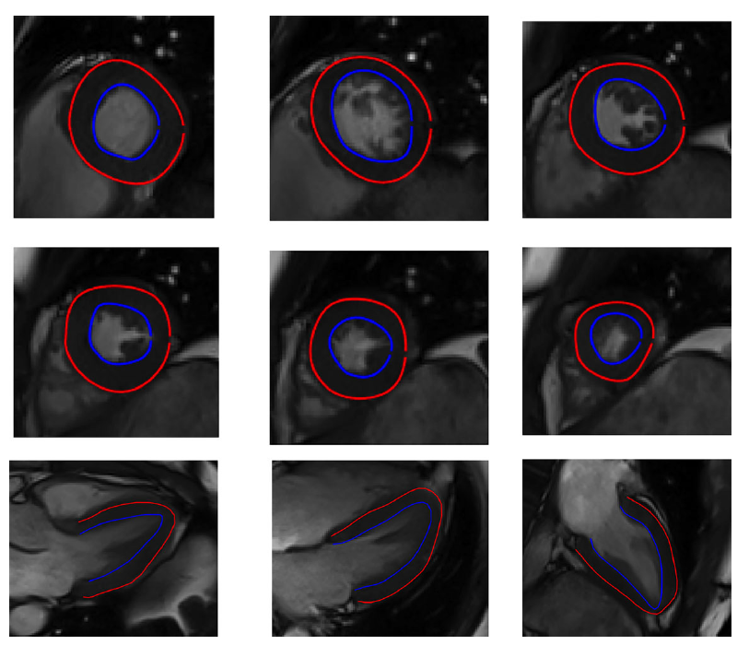
Image Annotation
Images come in the form of
Approximately 6 short axis images
3 long axis images

Slide 12
Image Annotation
Images come in the form of
Approximately 6 short axis images
3 long axis images
To create the mesh that is used in the models, we need to annotate the walls of the left ventricles
Annotation can be done automatically, but currently unreliable

Slide 13
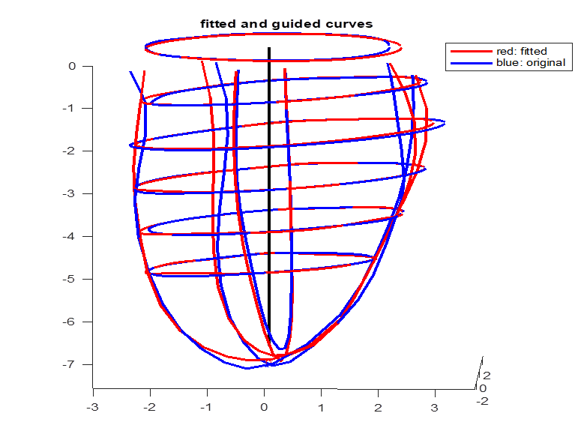
Annotated Images to Mesh
Annotation is then aligned, and a modelling process corrects any issues
This is then turned into a mesh

Slide 14
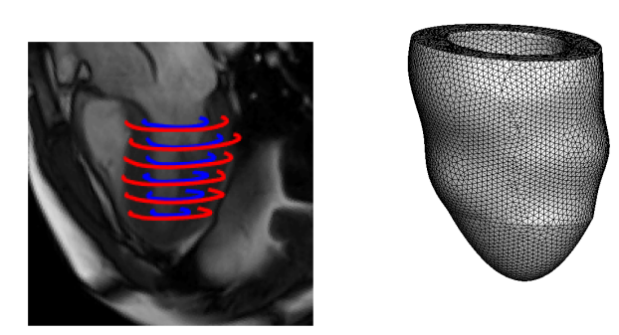
Short axis only
Currently we are only working with short axis images

Slide 15
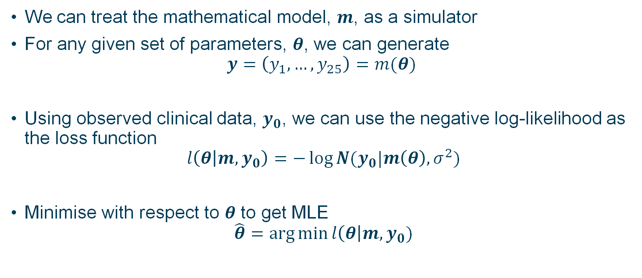
Optimisation of Mathematical Models
We can treat the mathematical model, $m$, as a simulator
For any given set of parameters, $θ$, we can generate
$$y=\left(y_{1}, …, y_{25}\right)=m(θ)$$
Using observed clinical data, $y_{0}$, we can use the negative log-likelihood as the loss function
$$l\left(θ | m, y_{0}\right)=−\log{N(y_{0}|m\left(θ\right), σ^{2})}$$
Minimise with respect to $θ$ to get MLE
$$\hat{θ}=\arg{\min{l\left(θ\right|m, y_{0})}}$$

Slide 16
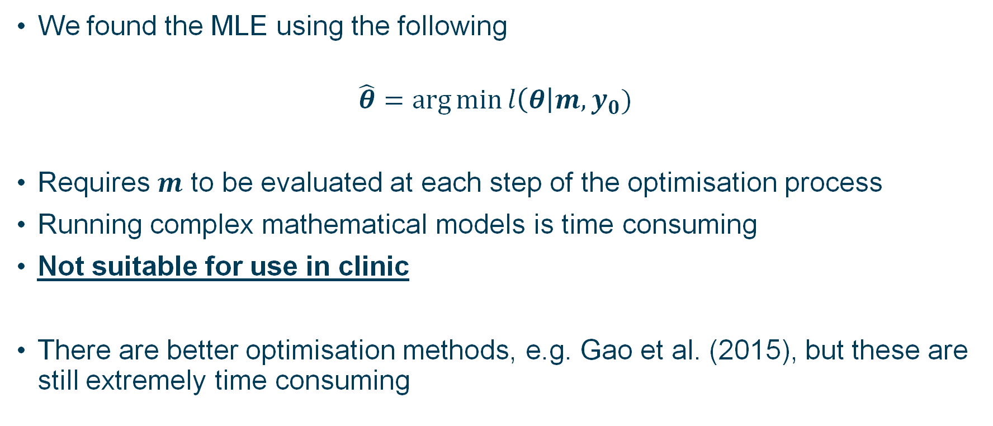
Problems with Optimisation
We found the MLE using the following
$$\hat{θ}=\arg{\min{l\left(θ\right|m, y_{0})}}$$
Requires $m$ to be evaluated at each step of the optimisation process
Running complex mathematical models is time consuming
Not suitable for use in clinic
There are better optimisation methods, e.g. Gao et al. (2015), but these are still extremely time consuming
Gao et al. (2015), J. Engineering Mathematics

Slide 17
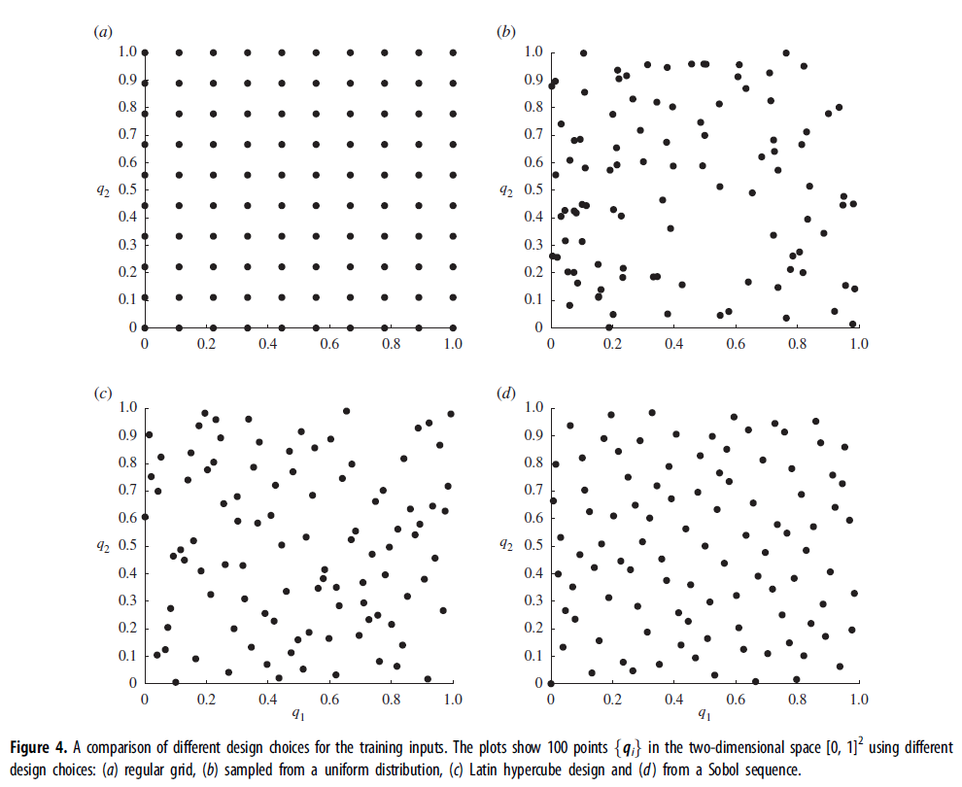
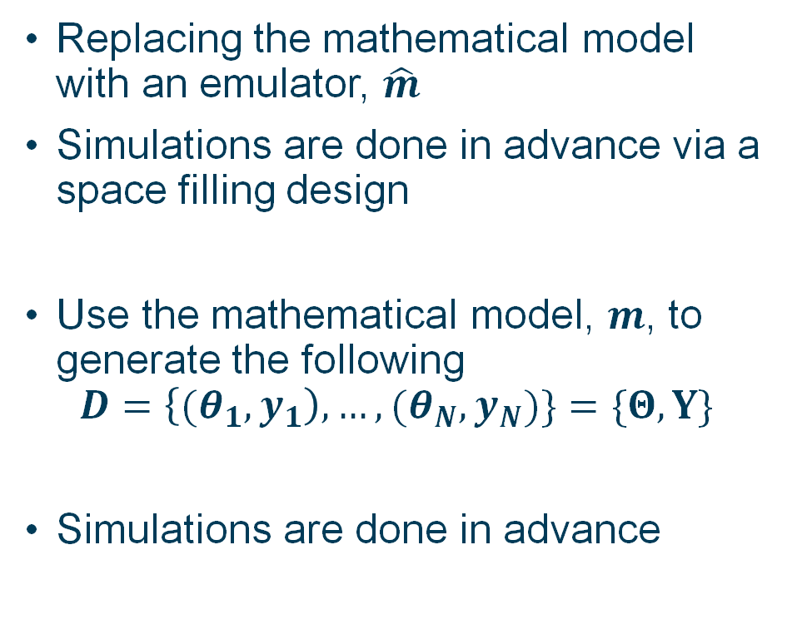
Emulation & Space Filling Designs
Replacing the mathematical model with an emulator, $\hat{m}$
Simulations are done in advance via a space filling design
Use the mathematical model, $m$, to generate the following
$$D=\left\{{(θ}_{1},y_{1}\right), …, (θ_{N},y_{N})\}=\{Θ,Y\}$$
Simulations are done in advance
Noè et al. (2019), Royal Society Interface

Slide 18
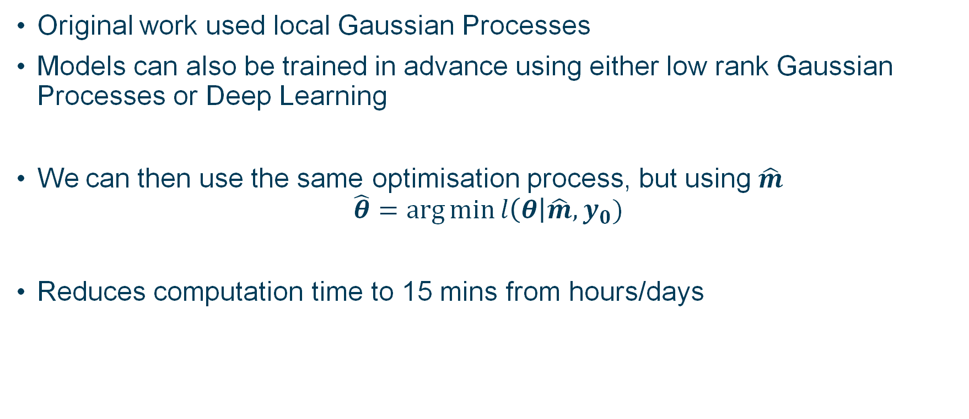
Statistical Emulation
Original work used local Gaussian Processes
Models can also be trained in advance using either low rank Gaussian Processes or Deep Learning
We can then use the same optimisation process, but using $\hat{m}$
$$\hat{θ}=\arg{\min{l\left(θ\right|\hat{m}, y_{0})}}$$
Reduces computation time to 15 mins from hours/days
Davies et al. (2019), JRSS-C

Slide 19
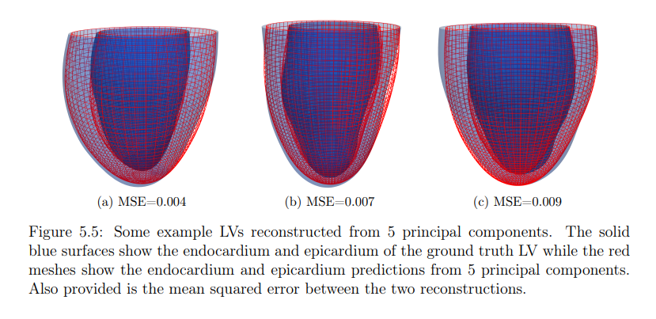
Extension to New Patients
Work can be extended to work for multiple patients
3D mesh can be represented through PCA
PCA parameters can then be used as parameters within the emulator
For a new patient, PCA components can be calculated and used as fixed components in the optimisation procedure
Lazarus (2022), PhD Thesis

Slide 20
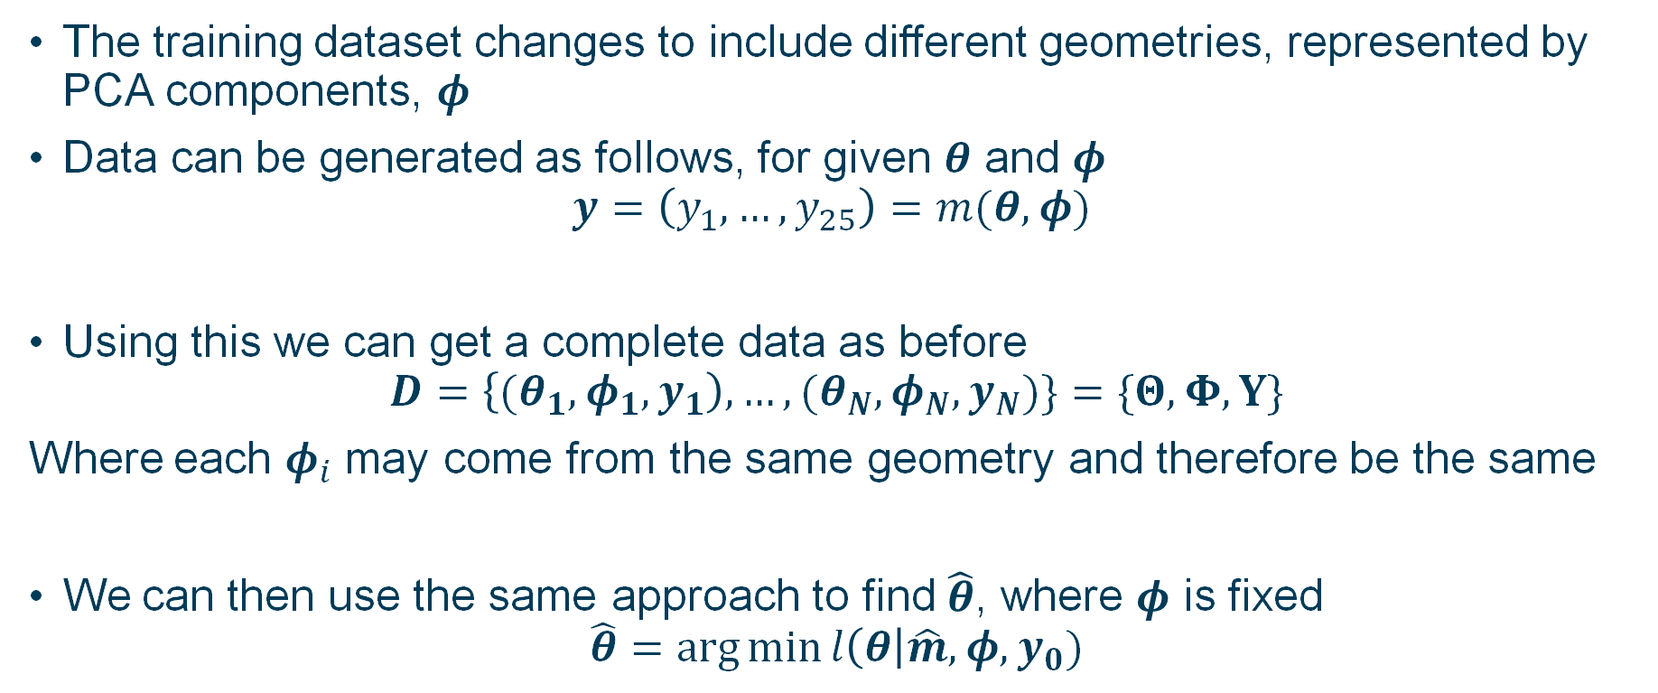
Extension to New Patients
The training dataset changes to include different geometries, represented by PCA components, $φ$
Data can be generated as follows, for given $θ$ and $φ$
$$y=\left(y_{1}, …, y_{25}\right)=m(θ, φ)$$
Using this we can get a complete data as before
$$D=\left\{{(θ}_{1},φ_{1},y_{1}\right), …, (θ_{N},φ_{N},y_{N})\}=\{Θ,Φ,Y\}$$
Where each $φ_{i}$ may come from the same geometry and therefore be the same
We can then use the same approach to find $\hat{θ}$, where $φ$ is fixed
$$\hat{θ}=\arg{\min{l\left(θ\right|\hat{m}, φ,y_{0})}}$$

Slide 21
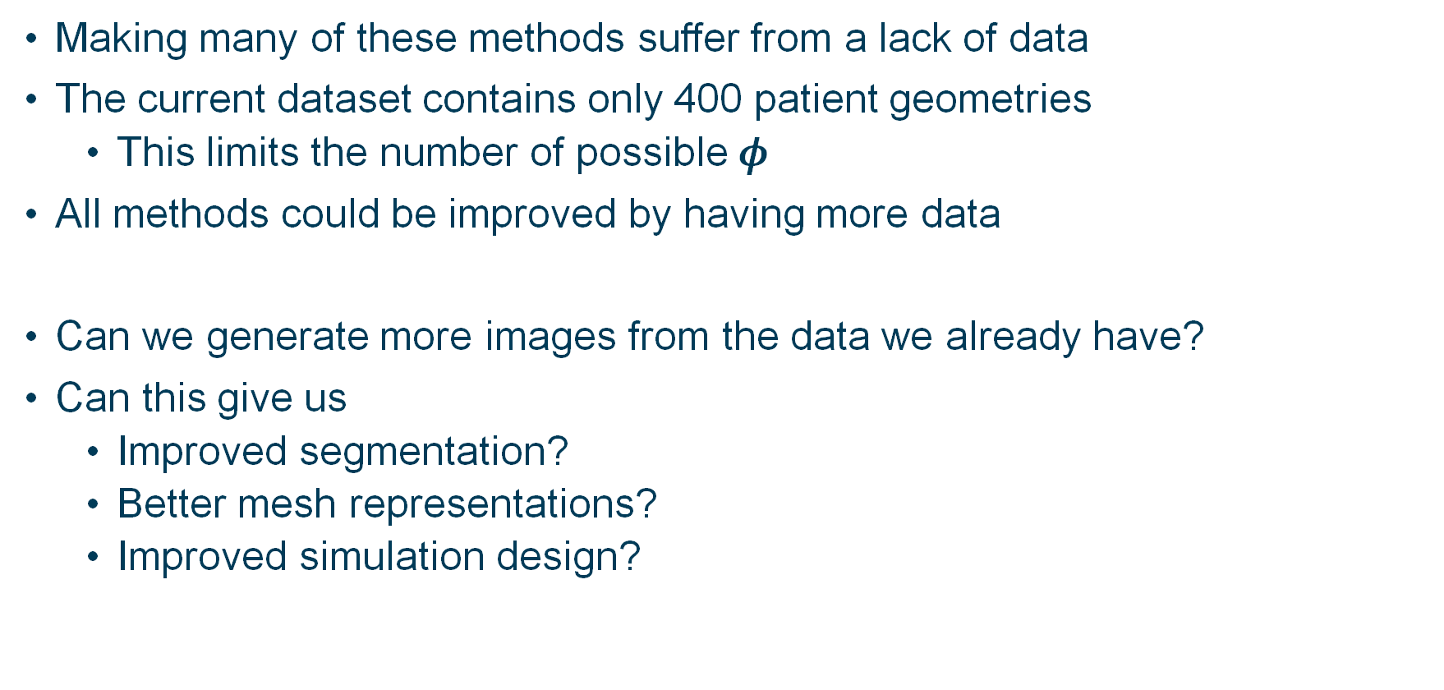
Potential Problem
Making many of these methods suffer from a lack of data
The current dataset contains only 400 patient geometries
This limits the number of possible $φ$
All methods could be improved by having more data
Can we generate more images from the data we already have?
Can this give us
Improved segmentation?
Better mesh representations?
Improved simulation design?

Slide 22
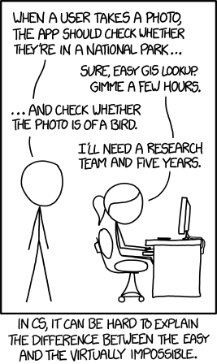
Machine learning and Image generation
XKCD (September 24, 2014)
Now lets switch gears a little ☺
Image analysis and generation in machine learning has exploded in the last 10 years going from low res images, to high res images which can be close to inventive.
Arguably part of a wider area of: Synthetic Data Generation
Notes:
In this section
Introduce concept of image generation
Introduce the concept of a GANs
Mention better stuff?
Go through our different GANs

Slide 23
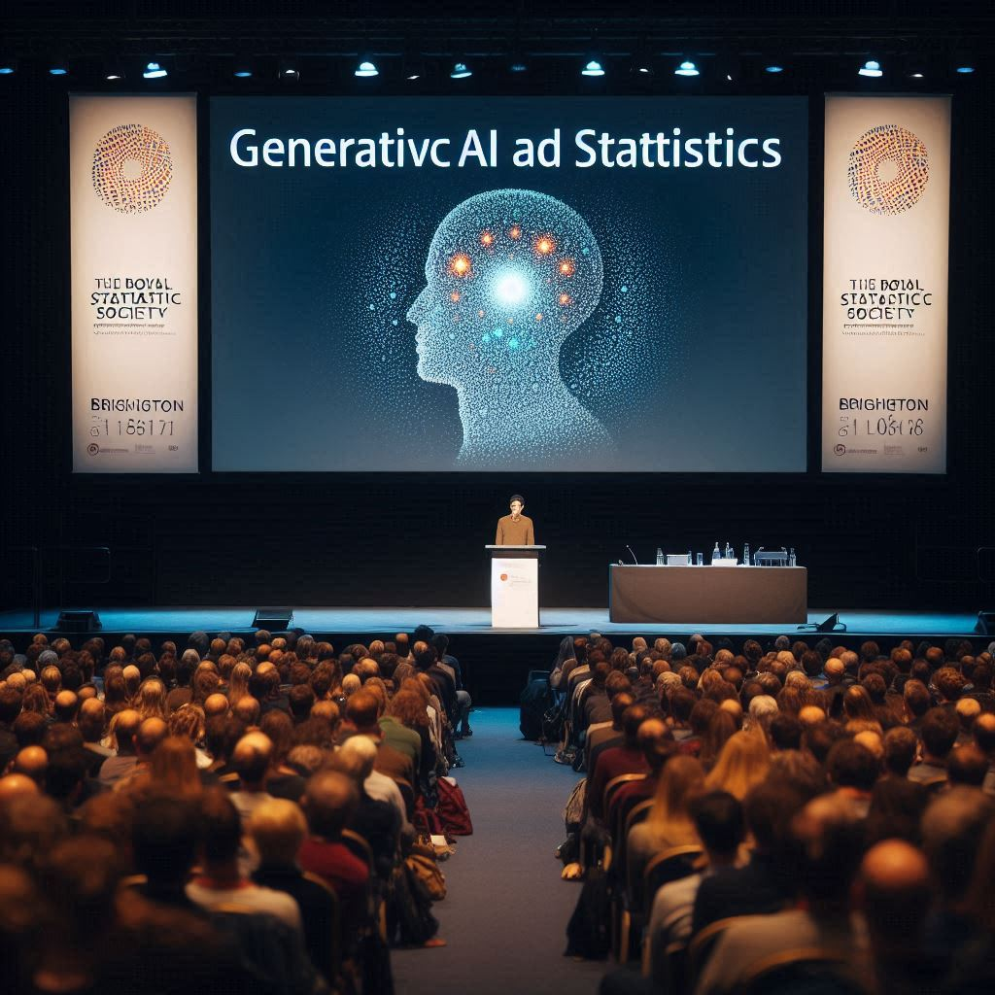
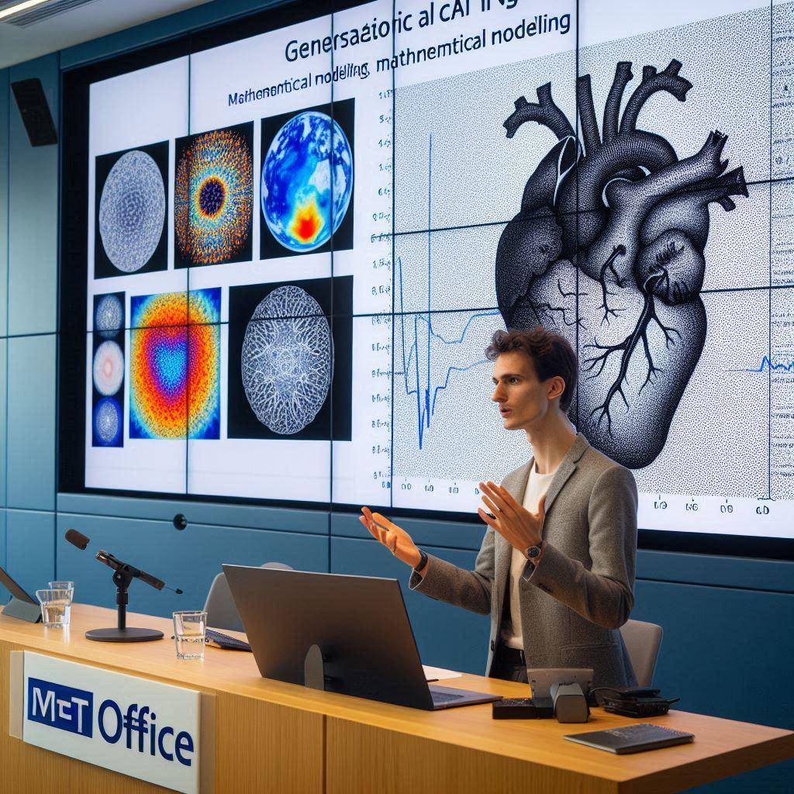
What AI thinks our presentation will look like:
Impressible images but (like me) could work on spelling (Sorry to my PhD supervisors!):

Slide 24
All very nice, but why should statisticians care?
Synthetic data has three common use cases in the literature:
Privacy enhancing (allowing data release with certain privacy guarantees e.g. Aim [1])
Fairness (correcting societal bias in the dataset to use to train an ML model)
Data Augmentation (topic of this talk):
Techniques in multiple domains: Images/text/graphs/tabular etc
Also used for model distillation or otherwise (See recent LLM advances).
Includes older techniques like SMOTE for imbalanced data

Slide 25
How does his help us with Cardiac Modelling?
What do we need to generate to help us in our Cardiac Modelling:
Generate sets of Realistic heart images
So we can:
Create meshes from these images
Run our complex simulations on the fake images
Improve our emulation using this extra data
Effectively an “intelligent” space filling design
For this proof of concept…

Slide 26
How do you do it? Generative Adversarial Network (High Level Overview)
Discriminator is trained to fool
the generator
Generator is trained to fool
the discriminator
Discriminator
Data
Real
Or
Fake
Random draw
(Usually
Multidimensional
Gaussian
With μ=0
And σ = I )
Synthetic Data
in the same format as the original
data
Generator
Classifier which tries
to tell if an image is
Real or fake
Maps the random draw
to an example of from
the distribution
Train the generator and discriminator at the same time

Slide 27
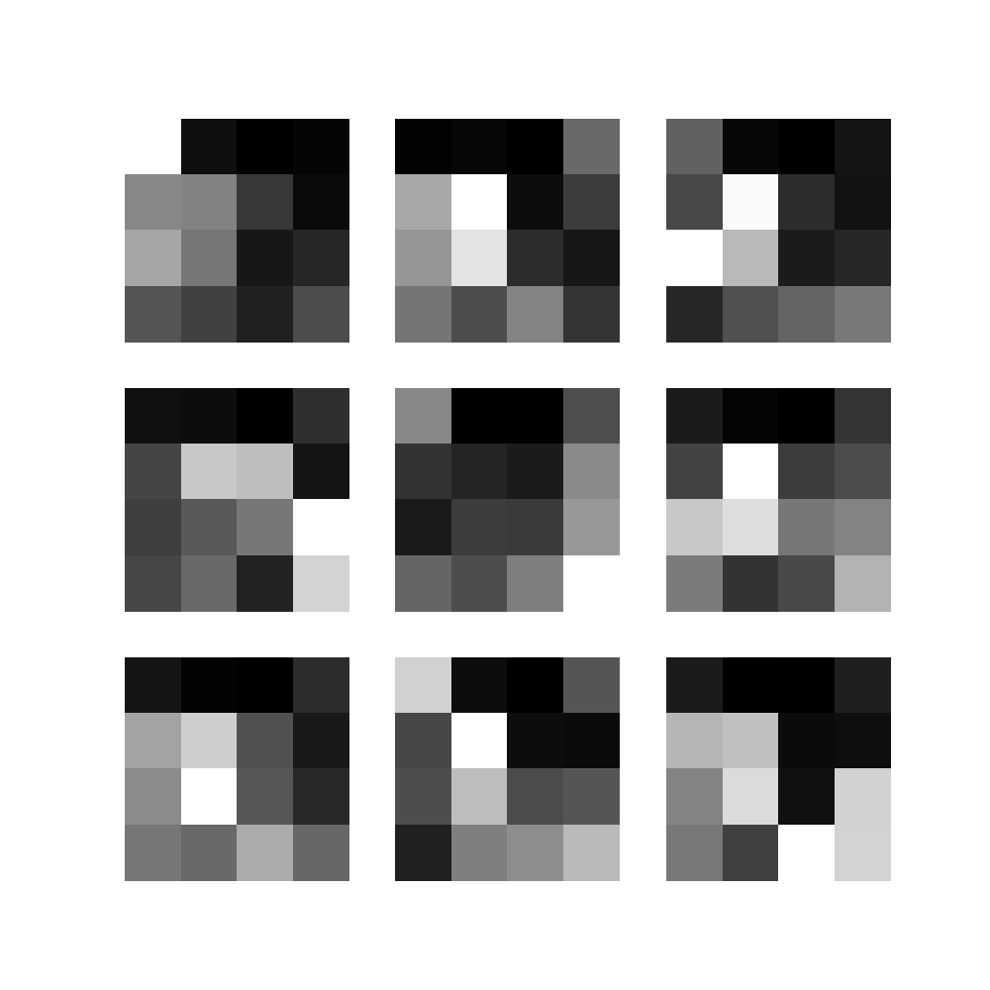
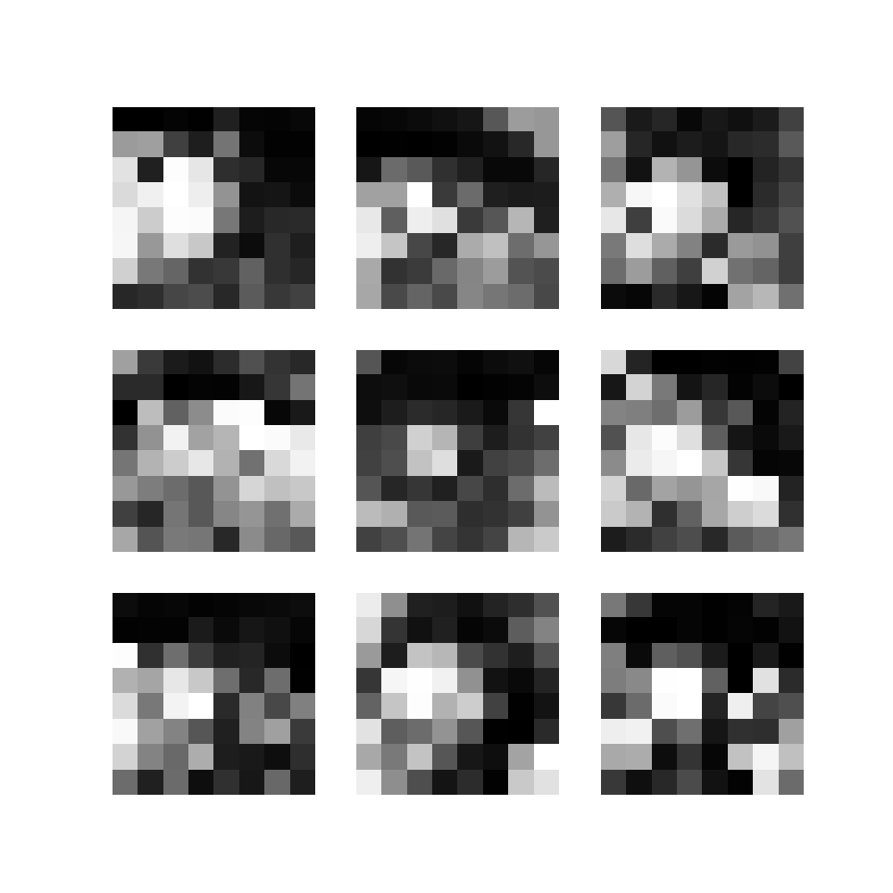
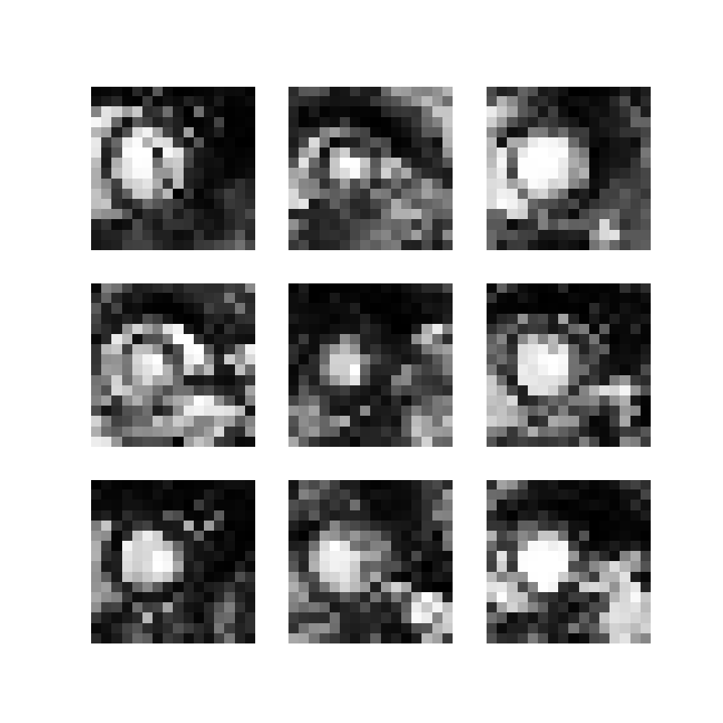
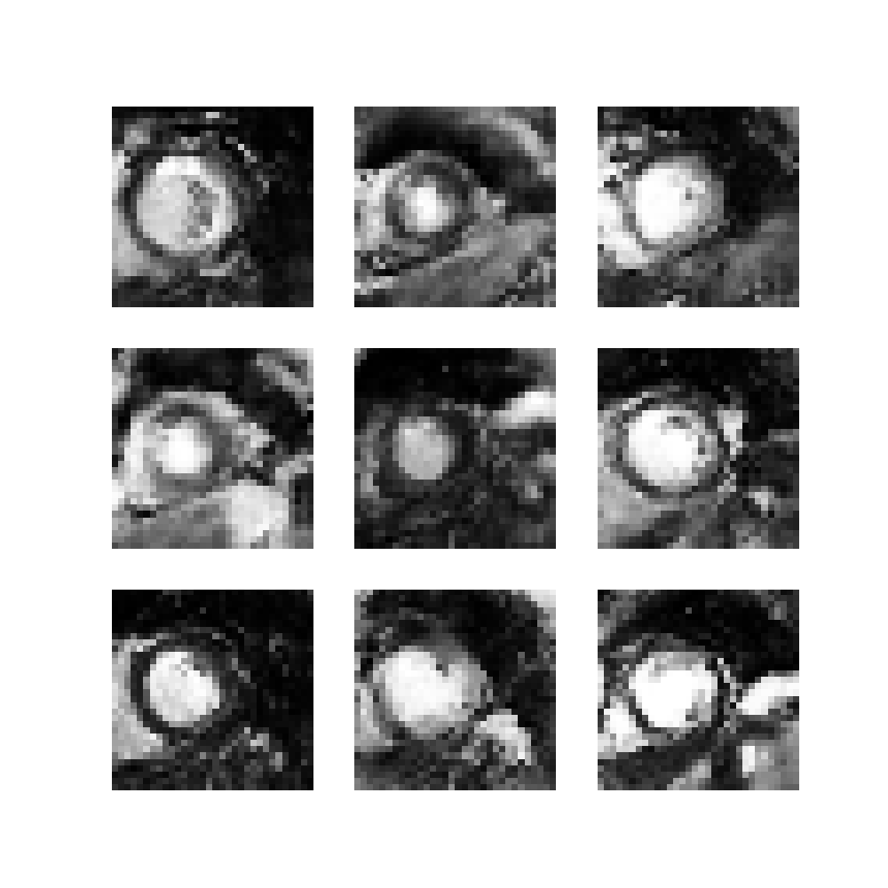
What did we do?
Progressive GAN (Karras et al. ICML 2018)
Highly suited for small datasets as we build up the problem
Idea First learn how to generate small images then build up to learn bigger images
Generator
Gen1
N(0,1) to
4x4
Gen 2
4x4 to
8x8
Gen3
8x8 to
16x16
Gen4
16x16 to 32x32
Gen5
32x32 to 64x64
Progressive GAN on Heart Data
=
Discriminator
Dis5
64x64 to 32x32
Dis4
32x32 to 16x16
Dis3
16x16 to
8x8
Dis2
8x8 to
4x4
Dis1
4x4 to
Real/Fake
=

Slide 28
What did we do?
Progressive GAN on Heart Data
Progressive GAN (Karras et al. ICML 2018)
Highly suited for small datasets as we build up the problem
Idea First learn how to generate small images then build up to learn bigger images
Generator
Gen1
N(0,1) to
4x4
Gen 2
4x4 to
8x8
Gen3
8x8 to
16x16
Gen4
16x16 to 32x32
Gen5
32x32 to 64x64
=
Phase 1
Discriminator
Dis5
64x64 to 32x32
Dis4
32x32 to 16x16
Dis3
16x16 to
8x8
Dis2
8x8 to
4x4
Dis1
4x4 to
Real/Fake
=

Slide 29
What did we do?
Progressive GAN on Heart Data
Progressive GAN (Karras et al. ICML 2018)
Highly suited for small datasets as we build up the problem
Idea First learn how to generate small images then build up to learn bigger images
Generator
Gen1
N(0,1) to
4x4
Gen 2
4x4 to
8x8
Gen3
8x8 to
16x16
Gen4
16x16 to 32x32
Gen5
32x32 to 64x64
=
Phase 2
Discriminator
Dis5
64x64 to 32x32
Dis4
32x32 to 16x16
Dis3
16x16 to
8x8
Dis2
8x8 to
4x4
Dis1
4x4 to
Real/Fake
=

Slide 30
What did we do?
Progressive GAN on Heart Data
Progressive GAN (Karras et al. ICML 2018)
Highly suited for small datasets as we build up the problem
Idea First learn how to generate small images then build up to learn bigger images
Generator
Gen1
N(0,1) to
4x4
Gen 2
4x4 to
8x8
Gen3
8x8 to
16x16
Gen4
16x16 to 32x32
Gen5
32x32 to 64x64
=
Phase 3
Discriminator
Dis5
64x64 to 32x32
Dis4
32x32 to 16x16
Dis3
16x16 to
8x8
Dis2
8x8 to
4x4
Dis1
4x4 to
Real/Fake
=

Slide 31
What did we do?
Progressive GAN on Heart Data
Progressive GAN (Karras et al. ICML 2018)
Highly suited for small datasets as we build up the problem
Idea First learn how to generate small images then build up to learn bigger images
Generator
Gen1
N(0,1) to
4x4
Gen 2
4x4 to
8x8
Gen3
8x8 to
16x16
Gen4
16x16 to 32x32
Gen5
32x32 to 64x64
=
Full model
Discriminator
Dis5
64x64 to 32x32
Dis4
32x32 to 16x16
Dis3
16x16 to
8x8
Dis2
8x8 to
4x4
Dis1
4x4 to
Real/Fake
=

Slide 32
What did we do? Modifying the discriminator for multi image generation
Classic GANs are designed to create one image we need to generate 6 (or more) grayscale slices of the heart jointly.
Generator
Adjusted the output tensor from 128x128x3 to
128x128x6 to represent each of the slices
Discriminator was specialized for this joint distribution of individual slices:
Single Slice Discriminator
Designed to tell if a single slice of our generated heart is real or fake
Discriminator
=
Combination Discriminator
Designed to tell if the joint generation slice of our generated heart is real or fake

Slide 33
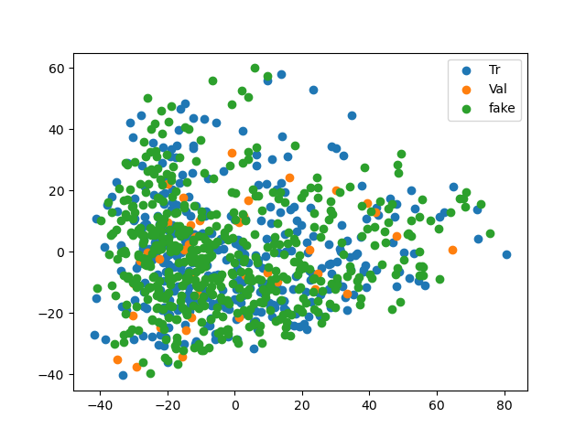
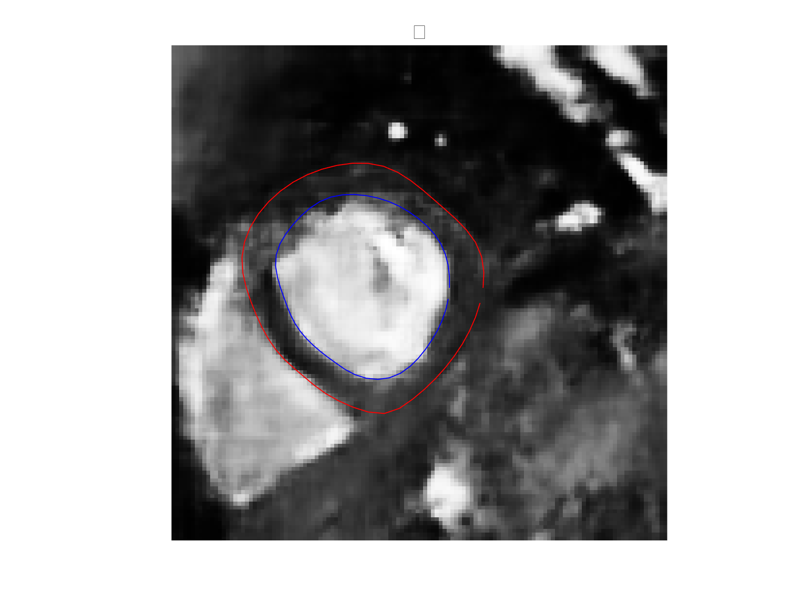
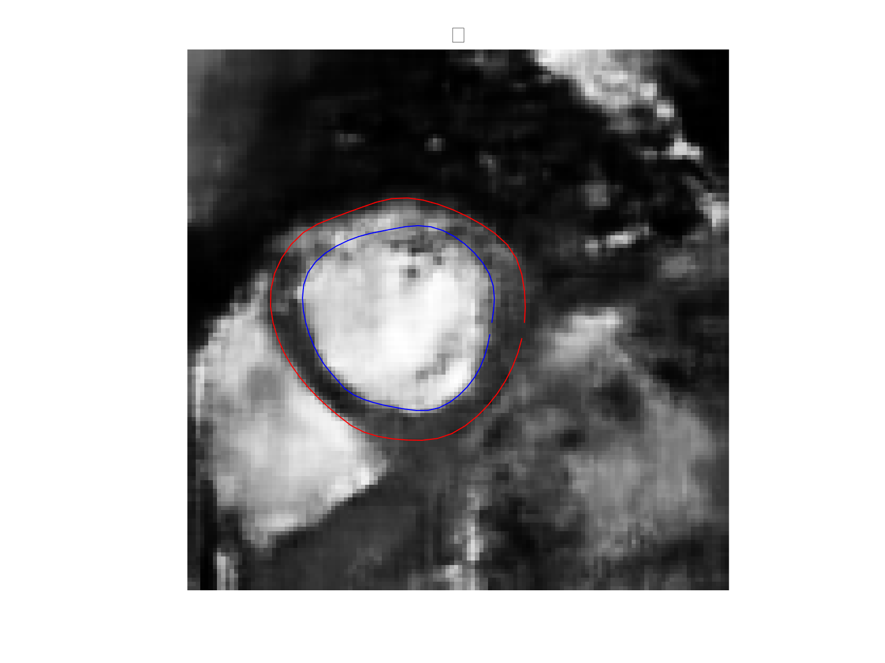
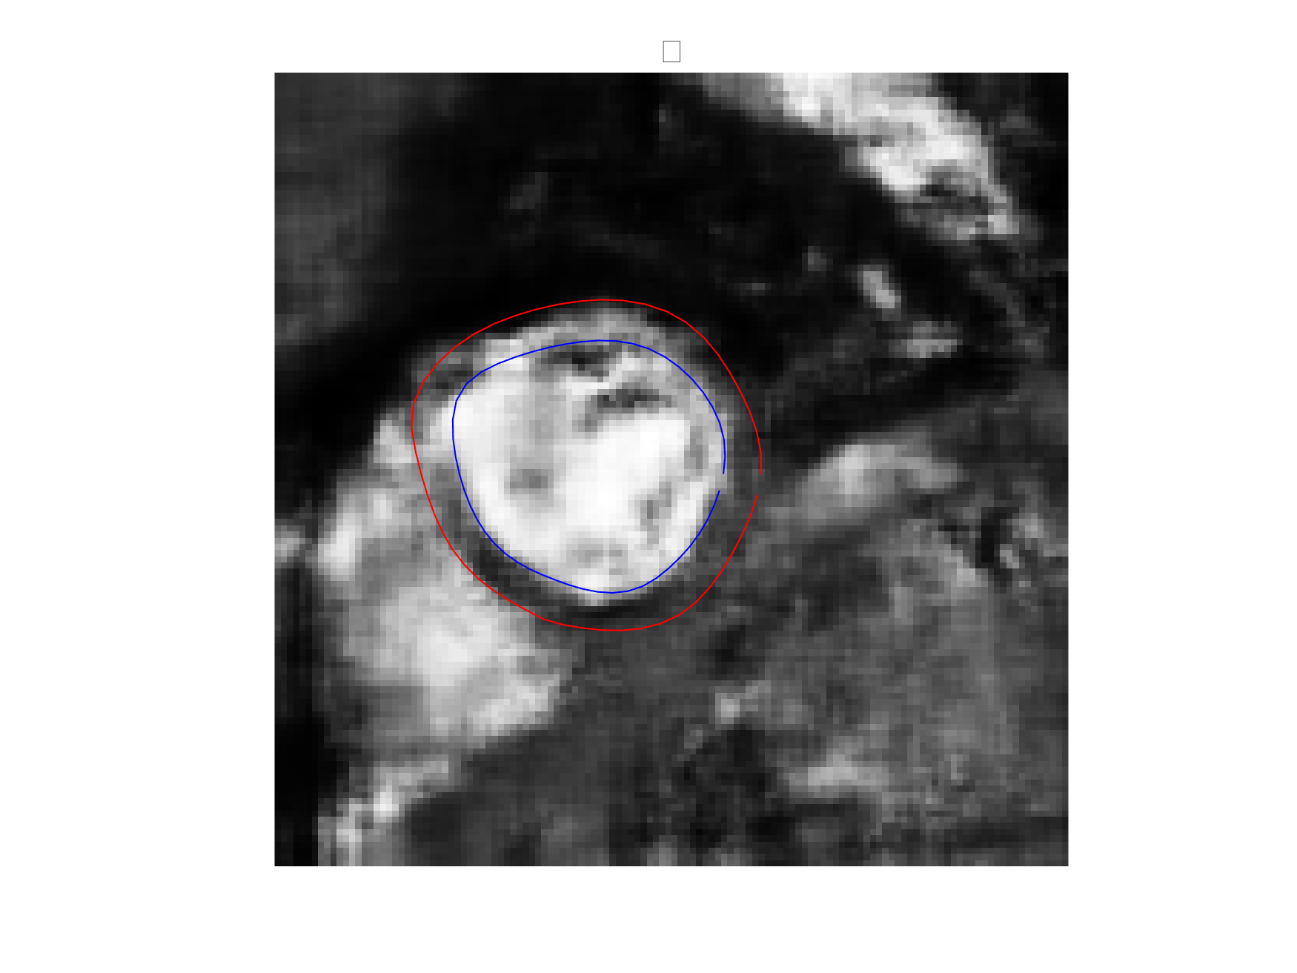
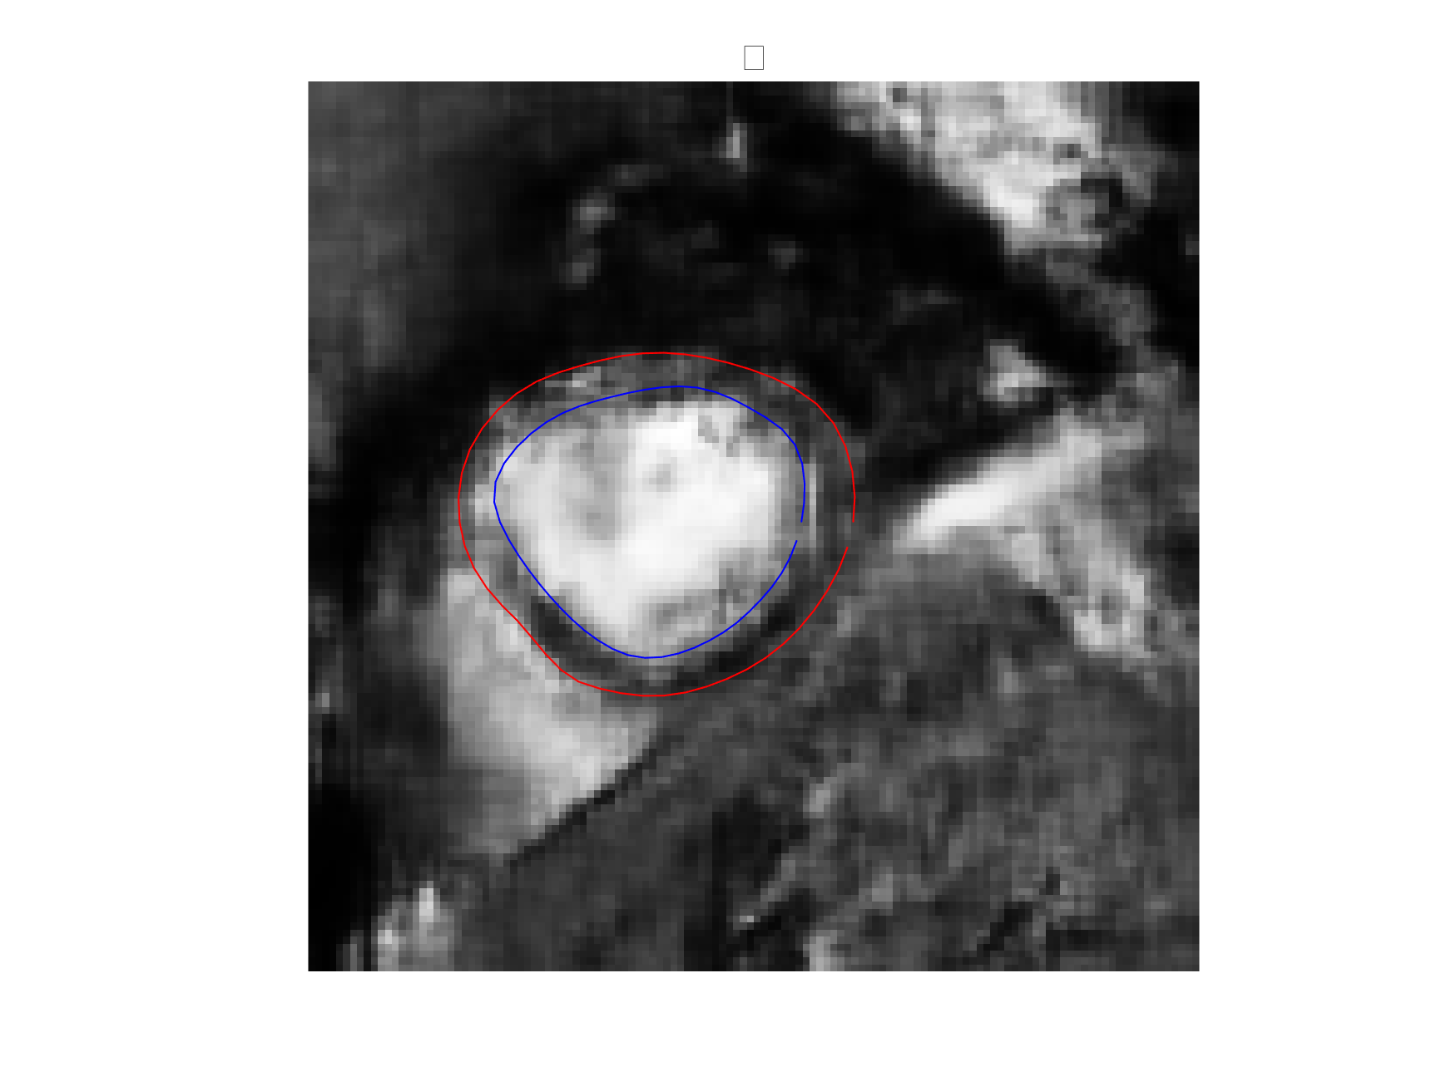
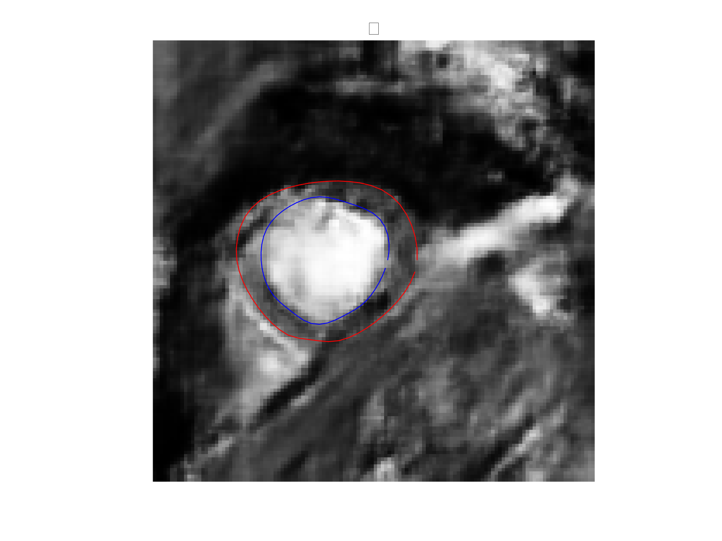
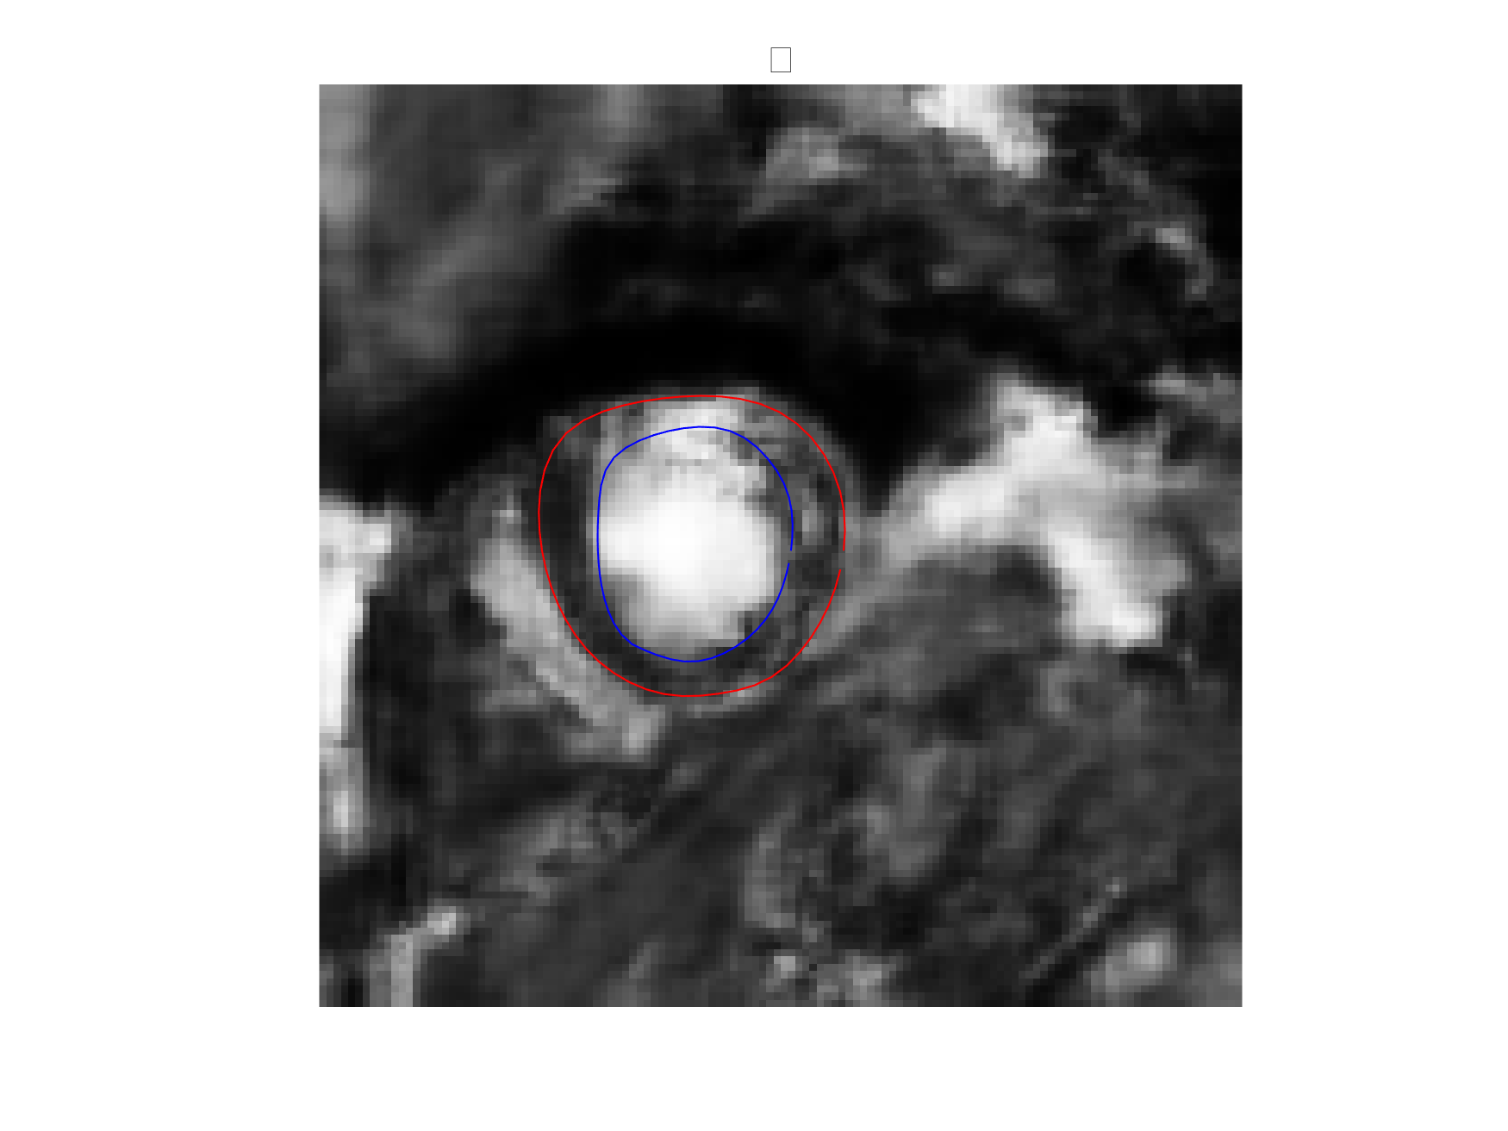
So how well do we do?
Generation produces reasonable heart images
However, image quality could be improved (current WIP slightly better)
PCA 2
PCA 1

Slide 34
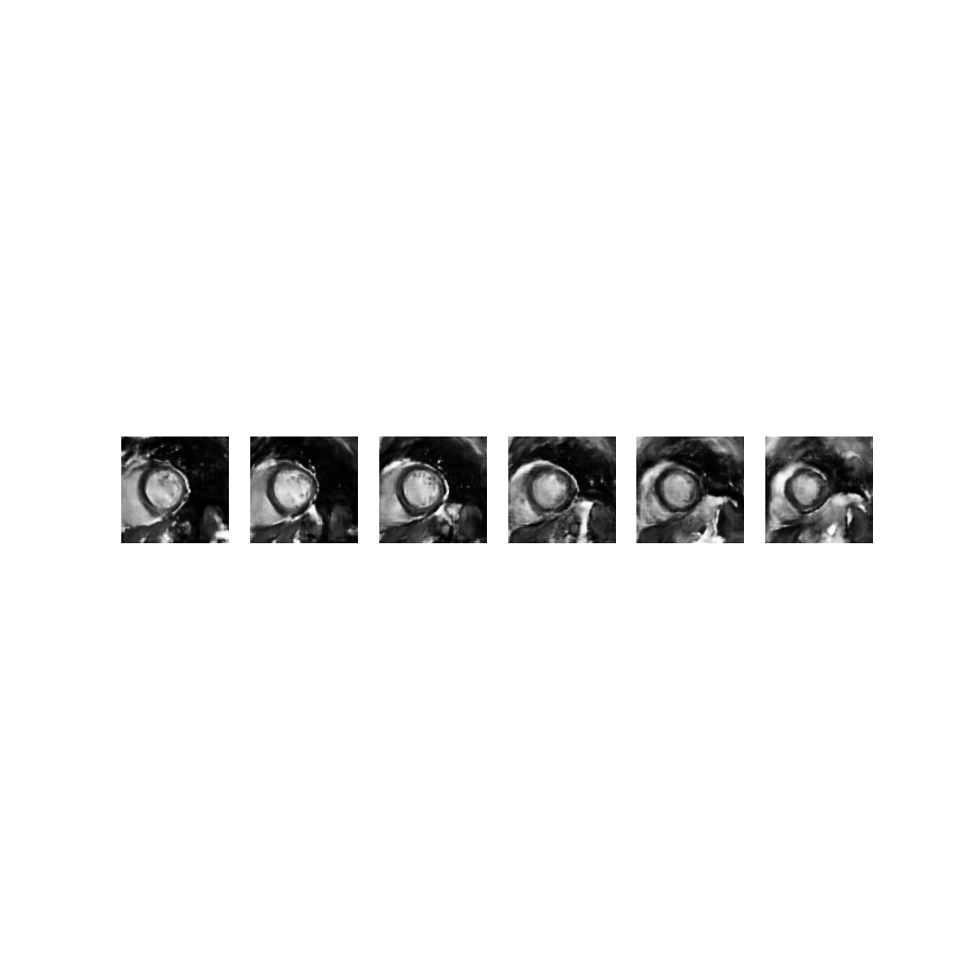
So how well do we do?
Generation produces reasonable heart images
However image quality could be improved
images
PCA 2
PCA 1

Slide 35
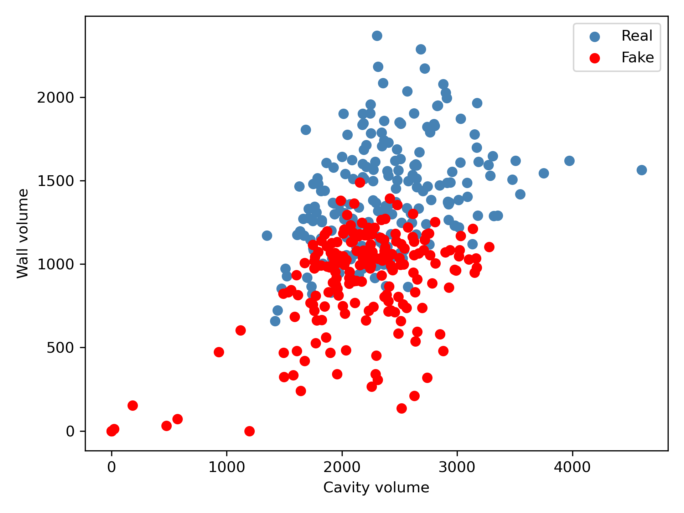
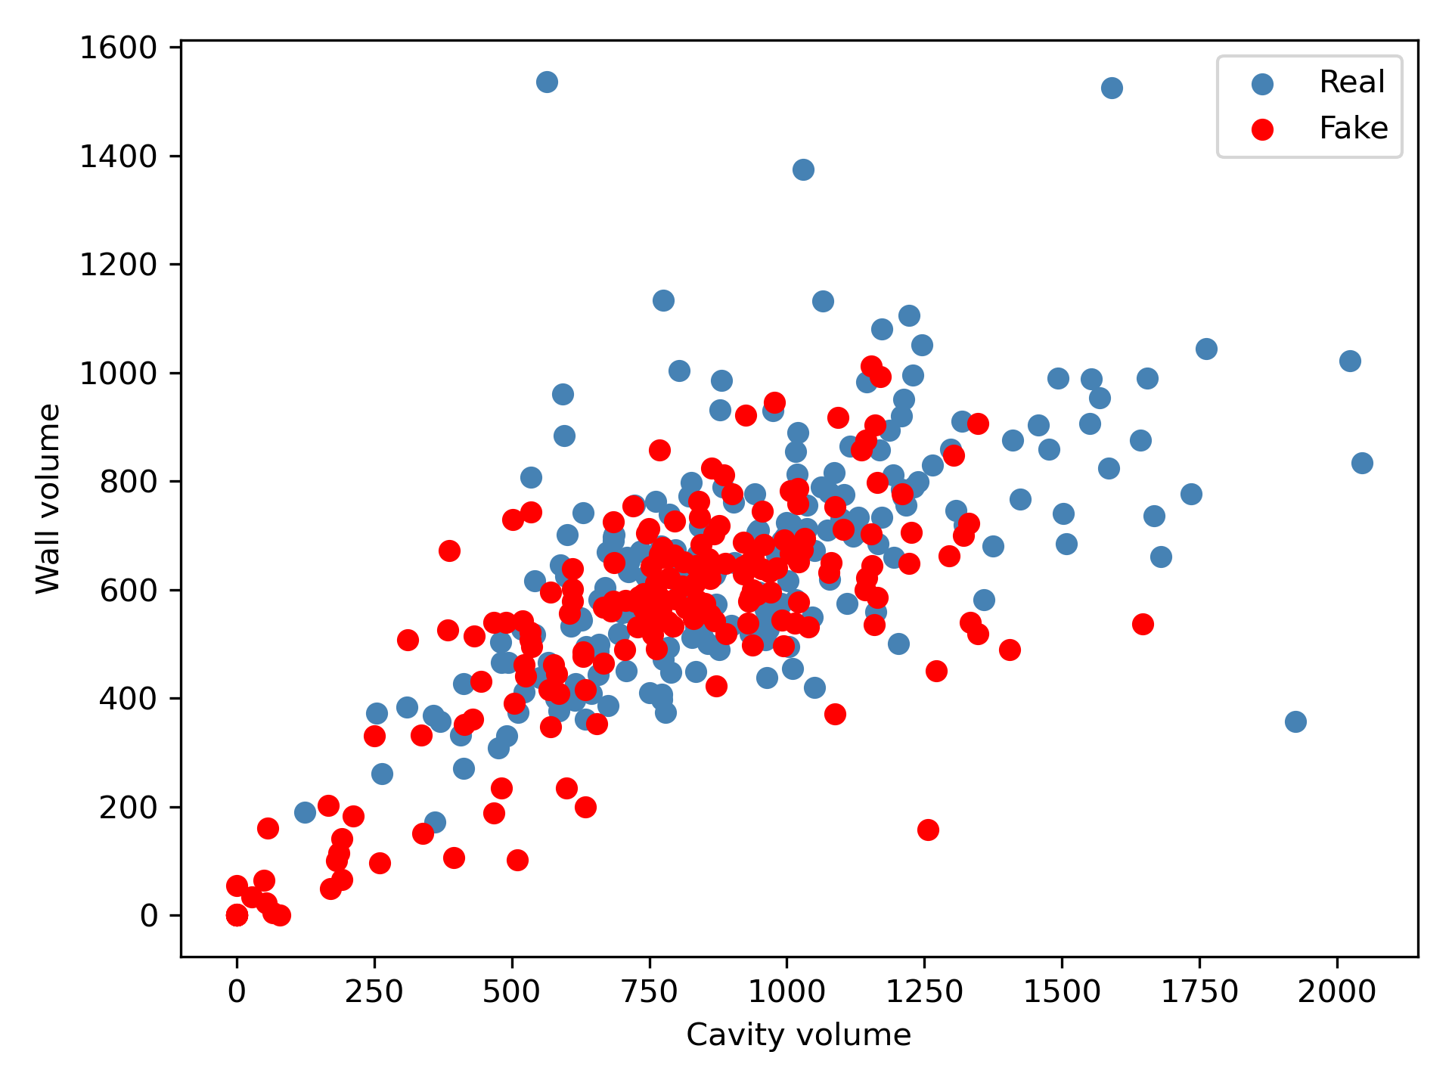
So how well do we do?
Generation produces reasonable heart images
However image quality could be improved
Slice 1
Slice 6

Slide 36
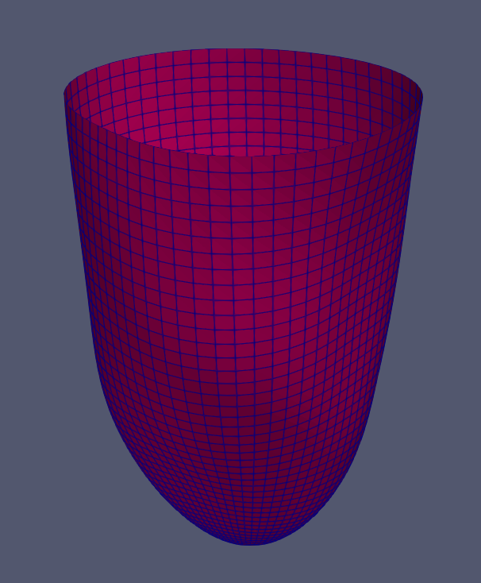
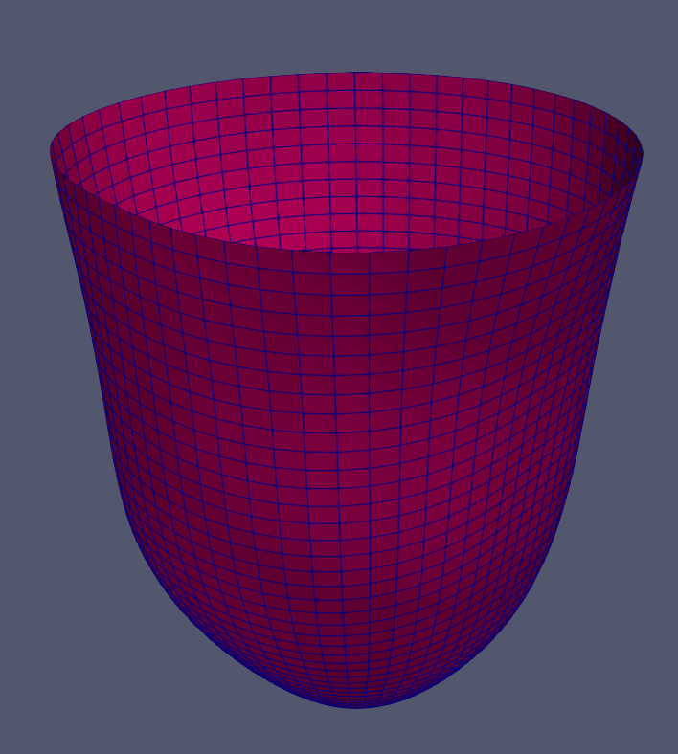
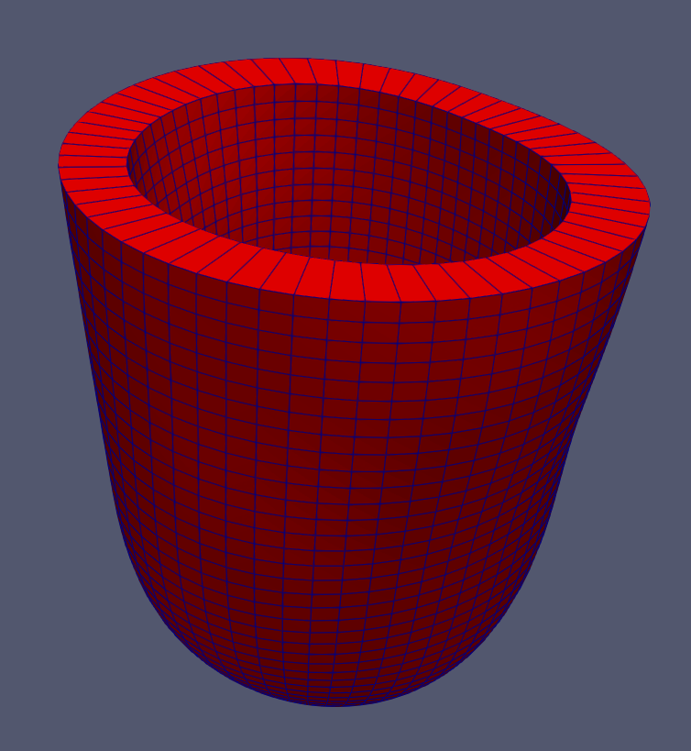
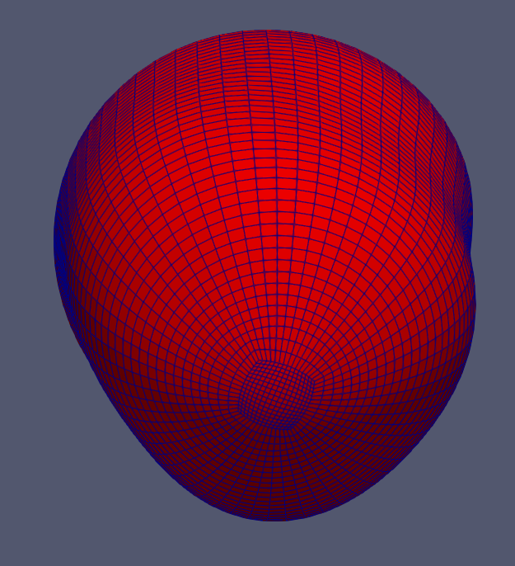
Geometry Construction
Segmentation of the LV wall: red (epicardial wall), blue (endocardial wall)
endocardial wall
epicardial wall
Reconstructed LV geometry

Slide 37
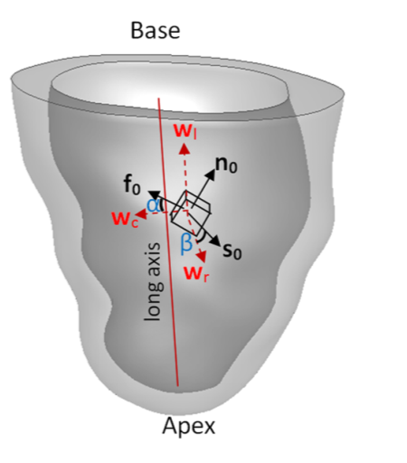
Passive filling simulation in the fake LV
End diastole filling
End of systole
Longitudinal & radial
Motions fixed
Longitudinal & radial
Motions fixed
ED pressure
ES pressure
Calcium transient
Without active contraction
With active contraction

Slide 38
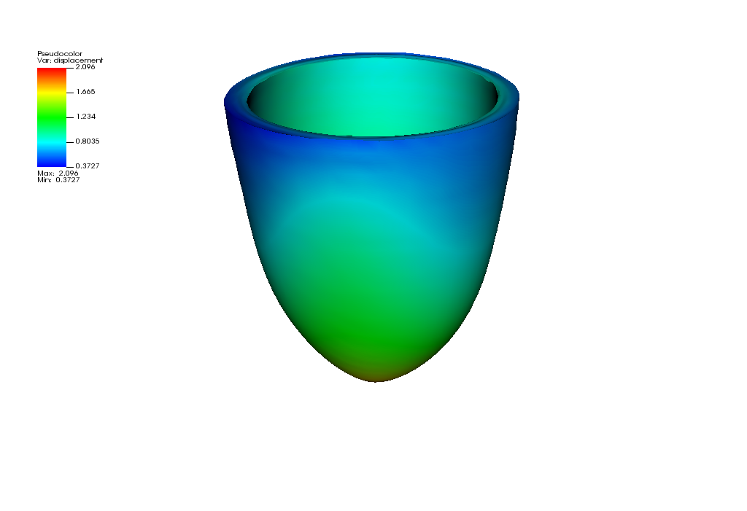
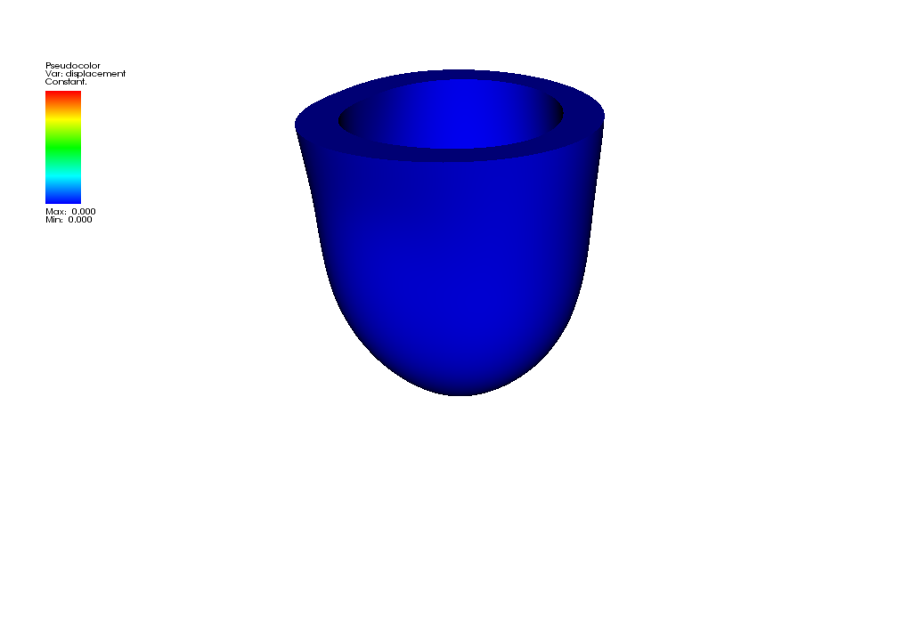
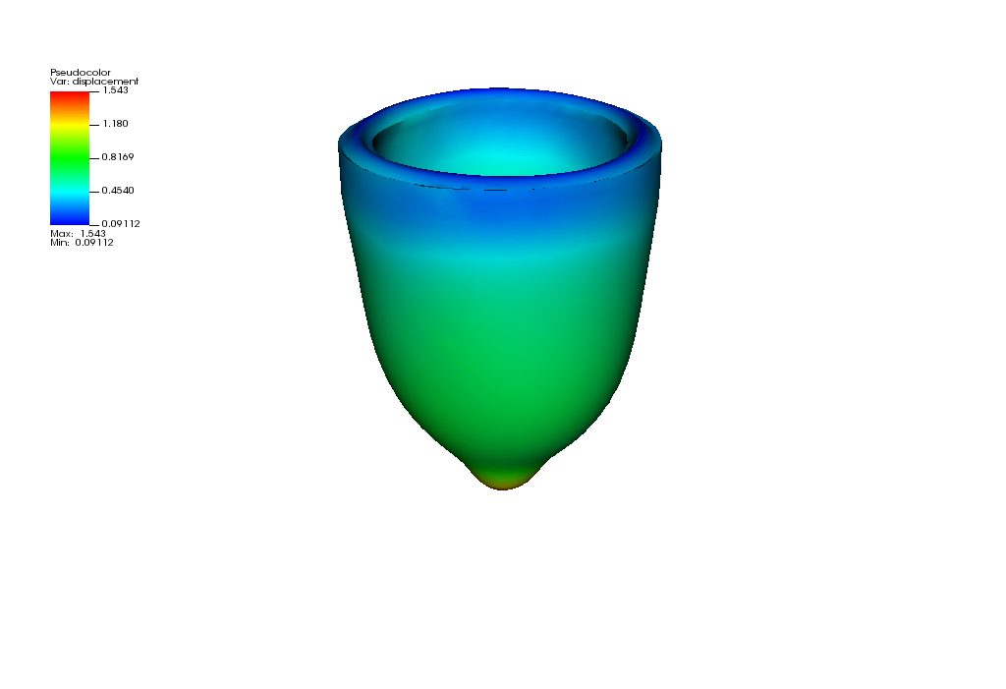
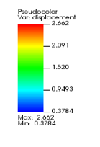
Passive filling simulation in the fake LV
Unloaded state
End of diastole
183mL
End of systole
82mL
Ejection fraction: 55% (within the normal range >50%)

Slide 39

From diastolic filling to systolic ejection

Slide 40
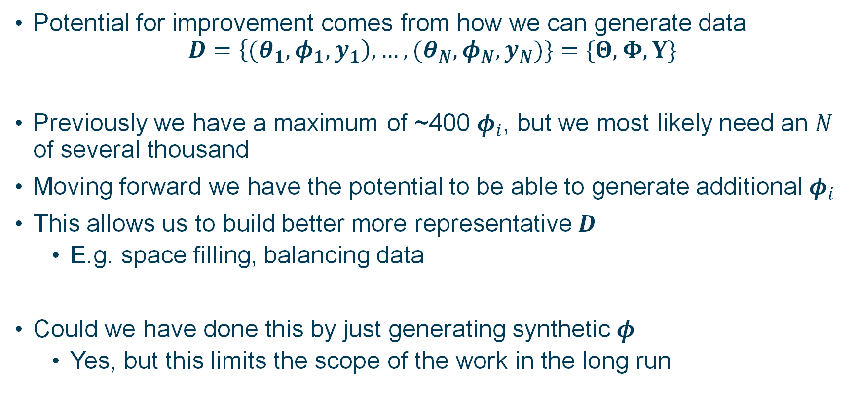
Potential for Improved Parameter Inference
Potential for improvement comes from how we can generate data
$$D=\left\{{(θ}_{1},φ_{1},y_{1}\right), …, (θ_{N},φ_{N},y_{N})\}=\{Θ,Φ,Y\}$$
Previously we have a maximum of ~400 $φ_{i}$, but we most likely need an $N$ of several thousand
Moving forward we have the potential to be able to generate additional $φ_{i}$
This allows us to build better more representative $D$
E.g. space filling, balancing data
Could we have done this by just generating synthetic $φ$
Yes, but this limits the scope of the work in the long run

Slide 41
Potential Applications – Emulation Training Data
Sparse data can be a problem for many applications
Generating additional images can help us understand the relationship between different patients by filling in the gaps
Could we use GANs to produce efficient space filling designs
PCA 2
PCA 1

Slide 42
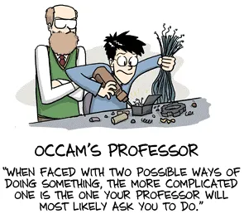
Future Work
Different sized hearts:
Currently assumes that hearts can be represented using 6 short axis slices.
Expand to using a variable number of slices for larger hearts
Different Architectures
VAE/StyleGan/Diffusion model/other techniques
VAEs are robust, Diffusion models are performant etc.
Transfer Learning
Enhance our results using transfer learning
Leverage both non-medical and medical datasets
Segmentation
Enhance/improve segmentation performance using our
synthetic images.
Needed for clinic use, where process must be done quickly
Student starting PhD in April working on synthetic
generation and physics informed machine learning
Source: PhdComics
Title: "Core Principles" - originally published 10/12/2009

Slide 43
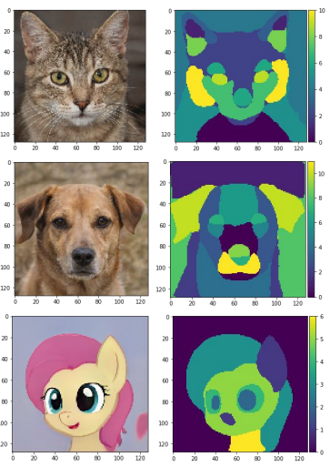
Potential Applications – Improved Auto-Segmentation
Can manually segment additional images to increase dataset for segmentation algorithm
Needed for use within a clinic, where the entire process must be done quickly
GANs can also be extended to generate the segmentations simultaneously to the images
Could this work with the small number of images we already have segmented?

Slide 44
Discussion Points
How can physics be incorporated into the image generation?
How do we incorporate segmentation uncertainty?
How do we build short and long axis alignment into the loss functions?
How do we incorporate disease status into images generation?
Leverage underlying probability distribution to improve other processes (e.g. improving model performance on low quality images)

Slide 45
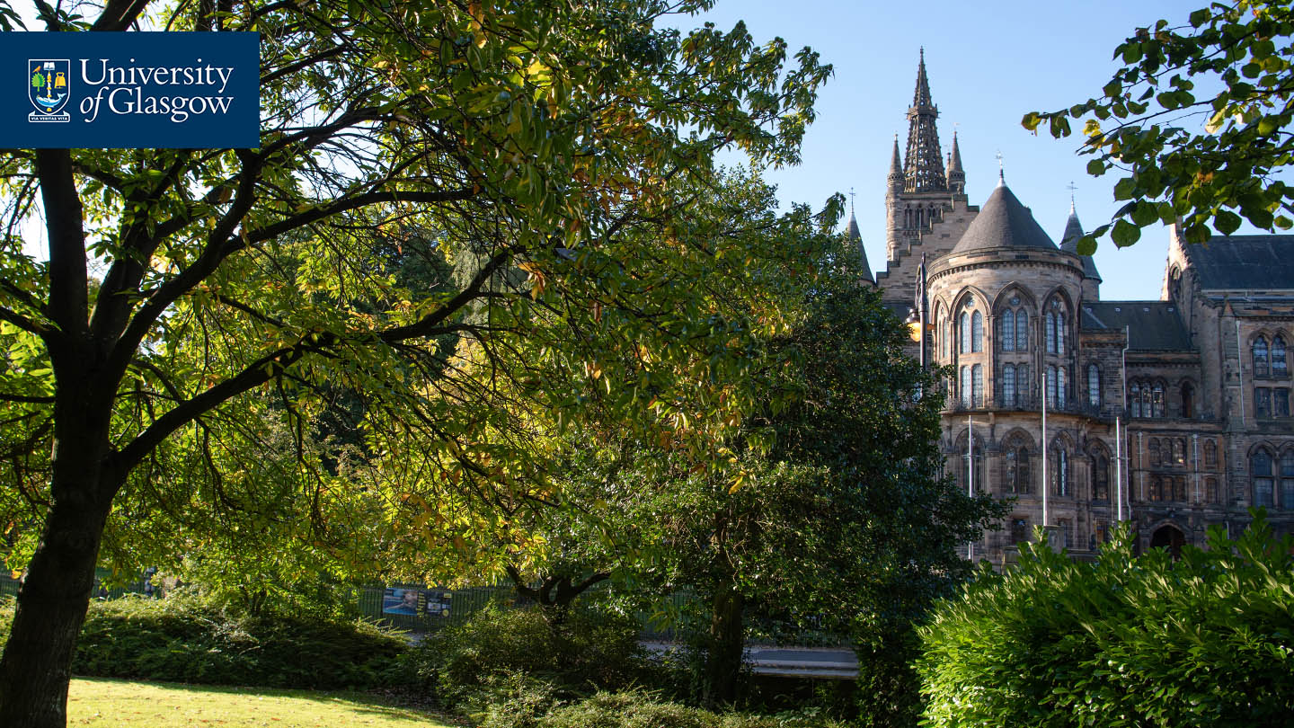
Thanks for Listening
Let me know if you have any questions
Or feel free to reach out at Vinny.Davies@Glasgow.ac.uk
Andrew.Elliott@Glasgow.ac.uk

